Slide 1


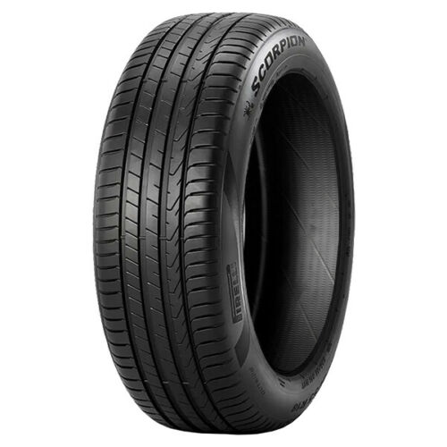
Energy Audit-Tyre Manufacturing
https://www.besolgroup.com/
Date: September 22, 2022

Slide 2
Definition of Energy Audit
Primary objective is to reduce energy consumption per unit of product output or to lower operating costs.
This entails verification, monitoring, analysis of production, sources and uses of energy at an establishment.
The whole process is documented through submission of a technical report.
The technical report gives recommendations for improving energy efficiency along with an action plan.
The technical report also includes recommendations based on the cost benefit analysis of the available data.

Slide 3


Why Energy Audit?
Energy (Electrical and Thermal) expenses are among the three (3) top operating expenses of a manufacturing operation.
Energy is considered as the top ranking area for the cost reduction.
Energy audit is the first step towards a operational excellence culture in the organization.
Energy audit provides a bench mark for managing energy in the organization.
Energy optimization leads to a sustainable and green planet by reducing carbon footprints.
BUT WHY?

Slide 4

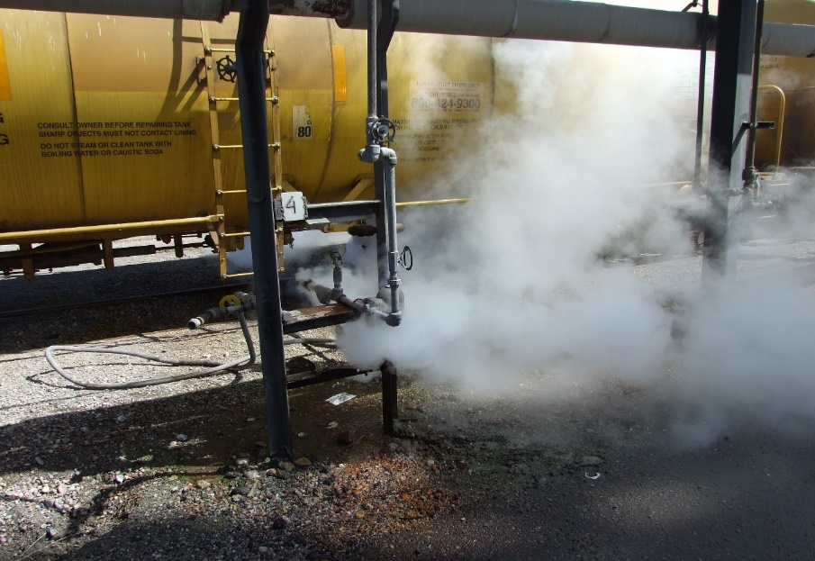

Types of Energy Audit
1- Preliminary energy audit
2- Targeted energy audit
3- Detailed energy audit
1- Preliminary energy audit
2- Targeted energy audit
3- Detailed energy audit

Slide 5



Preliminary Energy Audit
Preliminary energy audit uses existing or easily obtained data.
An overview of the prevailing practices with respect to plant and equipment operation and maintenance (O&M).
Identifies and documents the existing energy consumption area in the facility.
Estimates the scope of savings based on rule of thumb.
Lists down the most prominent areas of attention.
Identify immediate areas of improvement with low cost or no cost.
Sets a reference point.
Identifies area for more detailed study and measurement.

Slide 6
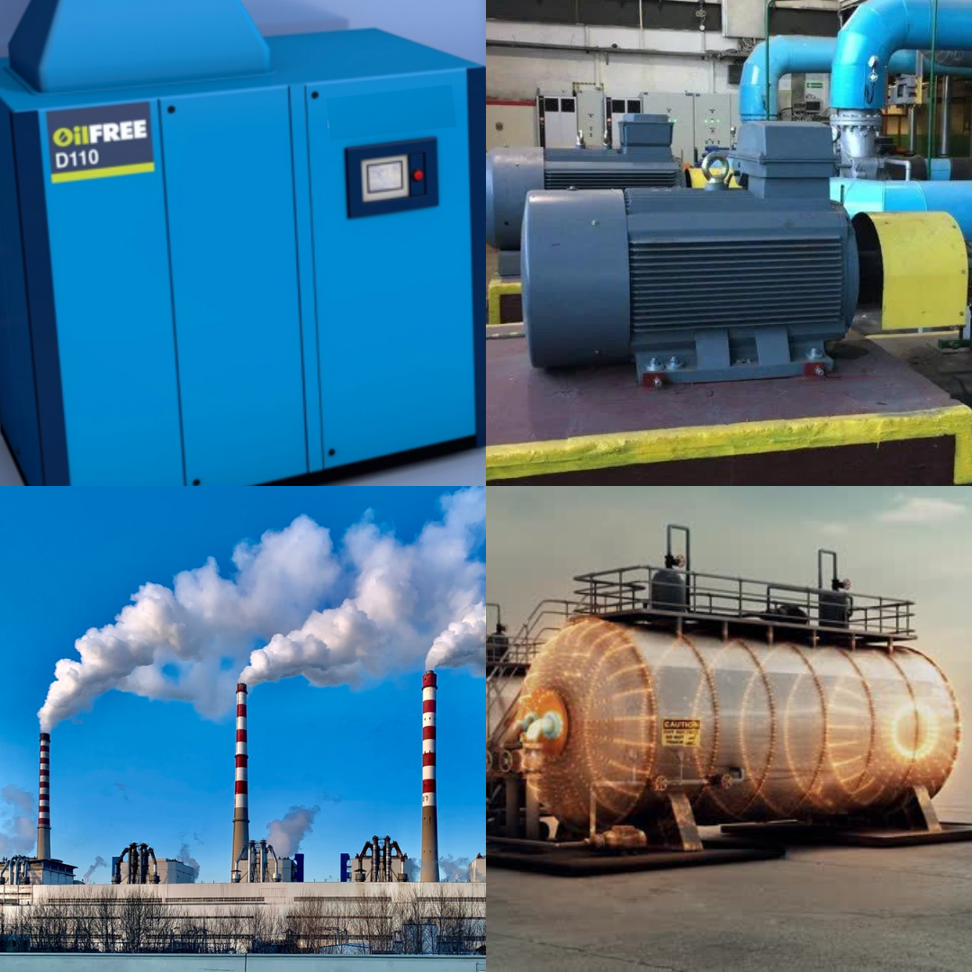
Targeted Energy Audit
Focused and detailed study of areas highlighted in the preliminary audit to identify the Energy Efficiency and Cost Reduction Opportunities in:
Steam systems
Process heating systems
Electric motor systems
Compressed air systems
Fan and pumping systems
HVAC systems
Lighting systems
Targeted audits also identifies multiple options supported by cost benefit analysis.

Slide 7

Detailed Energy Audits
This consists of a detailed inspection, survey and analysis of energy flows for energy conservation (recycling streams) in the facility.
This includes all the processes and systems, plants and equipment that consume energy.
The details provide data analysis in a holistic manner and pin point the areas of energy optimization in line with the business execution strategy of the enterprise.
A detailed action plan consisting of short, medium and long term actions and the related cost benefit analysis will be provided.

Slide 8

General Guidelines for Sustaining Efficient Energy Culture
Understand your energy use.
Set goals. Assess plants for energy savings.
Set a plan for improvement.
Develop good operations and maintenance practices.
Track and benchmark energy use.
Encourage behavior changes and engage employees.
Recognize and reward energy achievements

Slide 9
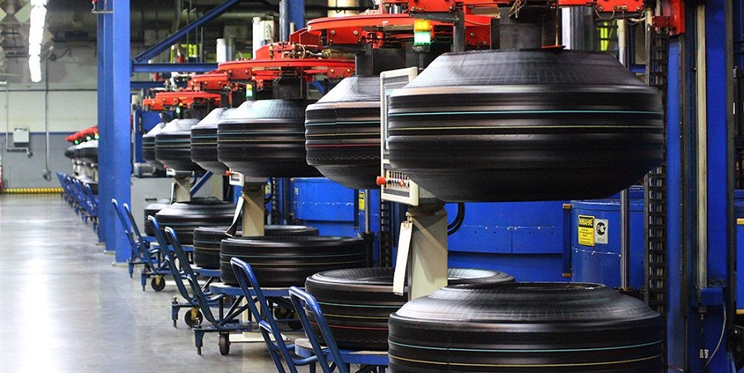
Tyre Manufacturing
.

Slide 10
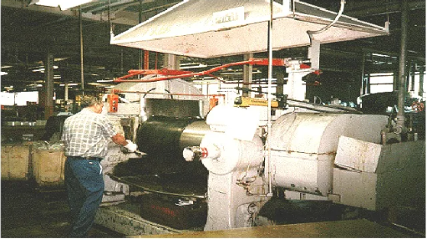
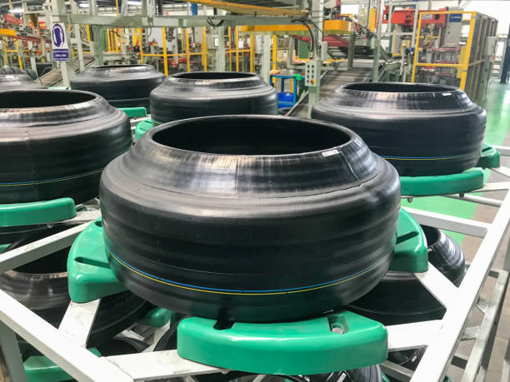
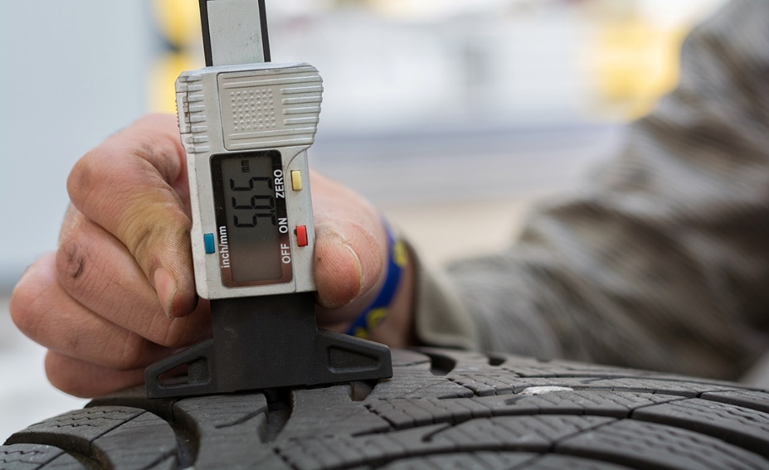
Major processes
The tyre production process consist of five sub processes. These include;
Material mixing and compounding
Material manufacturing
Tyre building
Valcunization-Curing
inspection

Slide 11
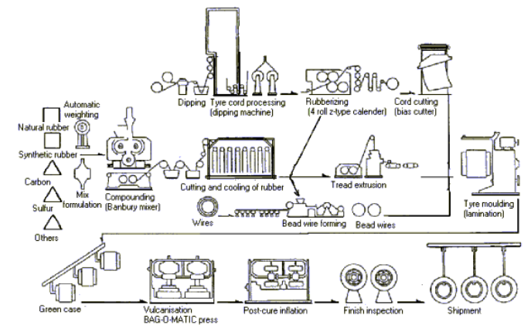
Tyre manufacturing process flow diagram

Slide 12
Energy Supply for mixing and compounding
In mixing and compounding process, electricity is needed the most. 1.7kWh/kg of tyre is required.
The compounding and mixing department consumes 46% of total electrical energy.
Energy Supply for mixing and compounding
Ref: U.S. DOE

Slide 13
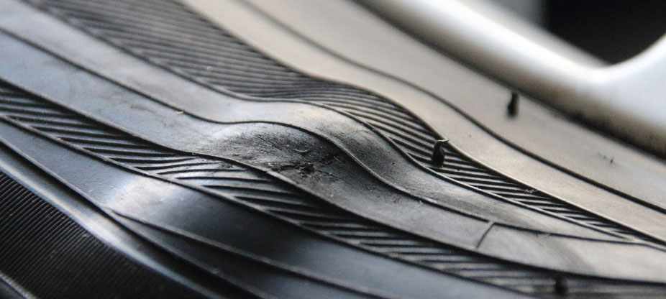
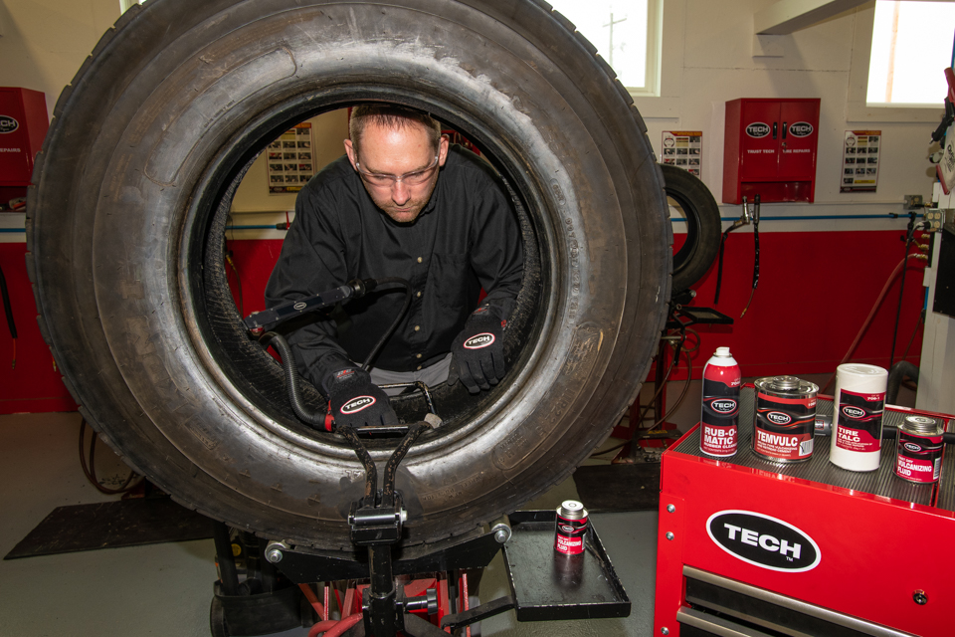
Major Energy Consumption Processes
The major process that consumed most of the energy are;
Preparation of Material
Calendaring
Moulding and Vulcanization

Slide 14
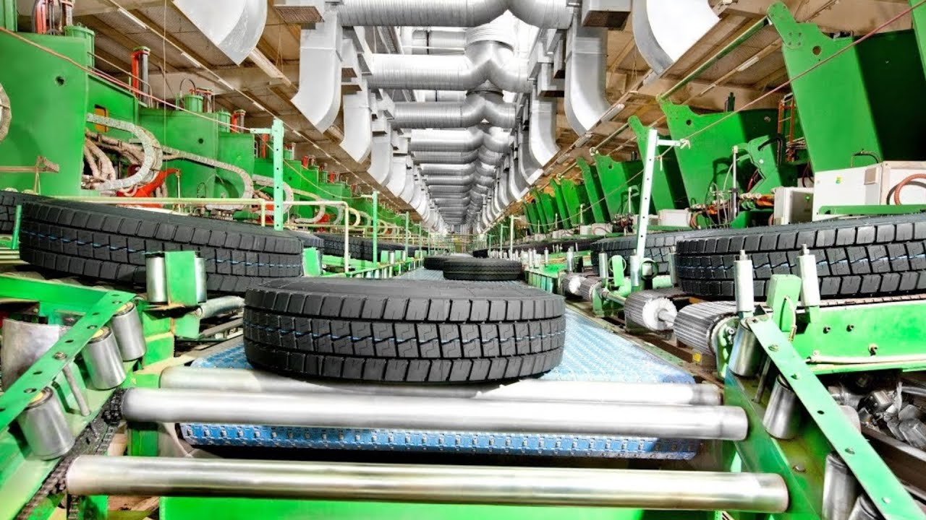
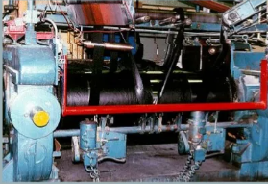
Preparation of Material
For the preparation of materials, 0.65KWh of electrical energy is required per kilogram(kg) of tyre.
Ref: U.S. DOE

Slide 15
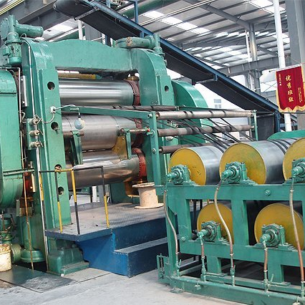
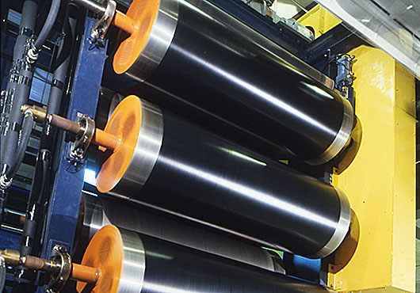
Calendaring
For the calendaring, 0.77kWh of electrical energy is required per kilogram(kg) of tyre.
Ref: U.S. DOE

Slide 16
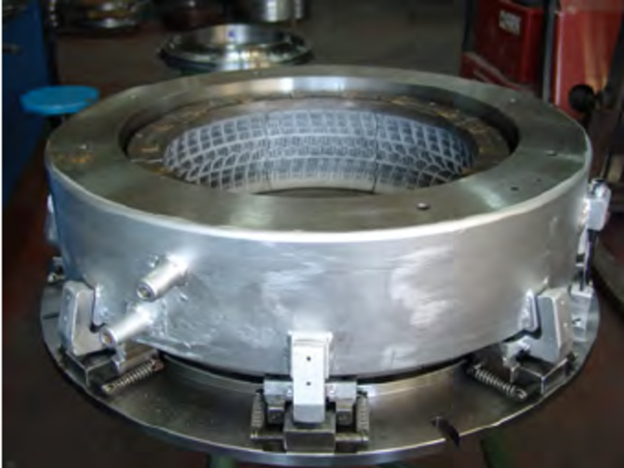
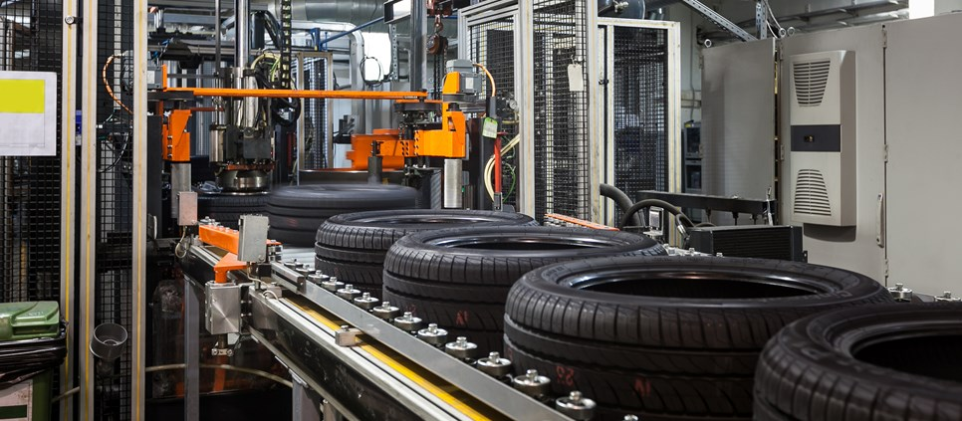
Moulding and Vulcanization
For the moulding and vulcanization, 2.54kWh of electrical energy is required per kilogram(kg) of tyre
Similarly, 2,221kcal of thermal energy is required per kilogram of tyre.
Ref: U.S. DOE

Slide 17
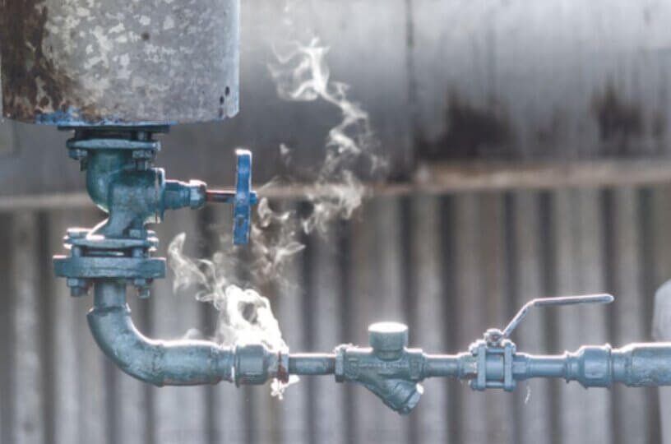

Potential Benefits
Indicative cost saving for 1 Ton per hour of condensate for 300 days operation is approximately Pak Rupees Two Million (2,000,000).
A 2 % saving of connected load of 1765Amps or 1500KVA system shall be around Two Million and three hundred thousand Pak Rupees (2,300,000/-) annually.
Up to 95% of a motor’s costs can be attributed to the energy it consumes and the maintenance expenses over its lifetime, while only around 5% of a motor’s costs are typically attributed to its purchase and installation

